Slide 1
Feeling Recoginition With Machine Learning

Slide 2
The Data Set
Ravdess Speech Recognition from Kaggle
This set contains 3 seconds length wav files of actors saying “Dogs are sitting by the door” or “Kids are talking by the door”
The Dataset is tagged with many labels, including the strength of the feeling and the kind of the feeling in each file.

Slide 3
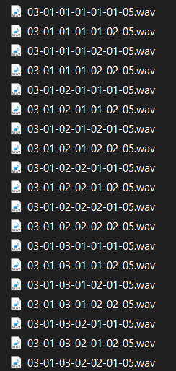
How the Data Set is Tagged?

Slide 4

Feature Extraction - How To Represent Audio with Numeric Values?
The Solution – MFCC (Mel Frequency Cepstral Coeffecients)
Used Librosa Module to extract MFCC’s from the wav files
Computed each coefficient its expectation and variance
Credit : Valerio Valerdo – The Sound of AI Youtube Channel

Slide 5
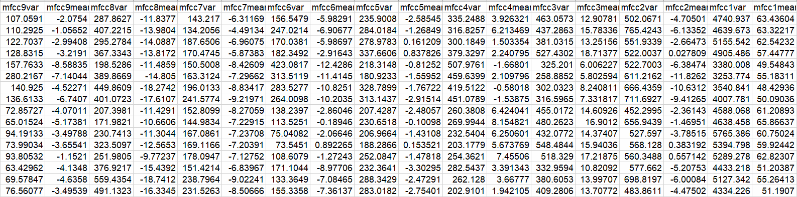
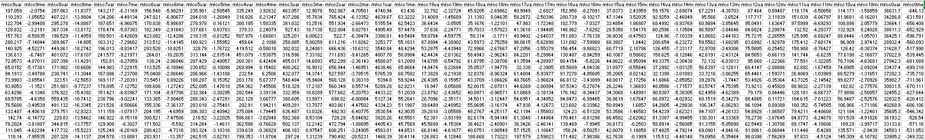
Two Tries: Using 13 MFCC’s Using 20 MFCC’S
Normalizing was needed

Slide 6
Two Questions:
In related work papers advanced paradigms such as Convolutional Neural Network or Recurrent Neural Network were proven as good for this mission, will more traditional and basic models will work?
Is there any pattern for the intensity of feelings, even between different feelings?

Slide 7
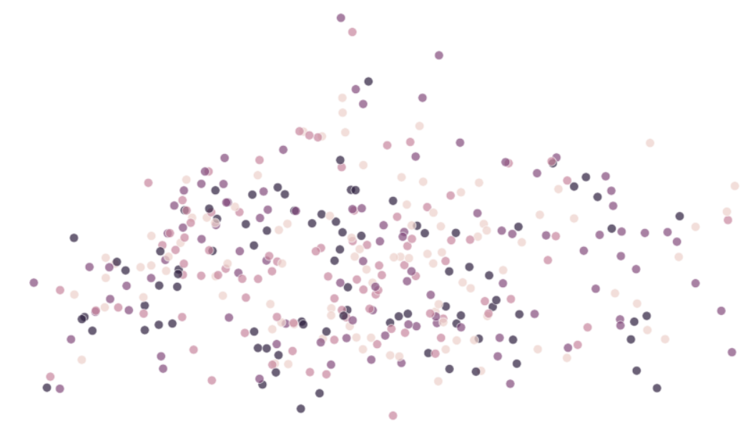
Different Emotions, Trying to understand the data with PCA

Slide 8
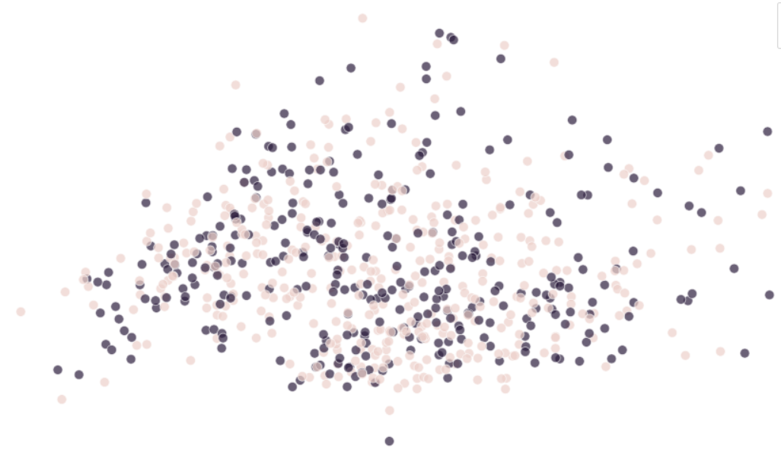
Emotions Intensity, Trying to understand the data with PCA

Slide 9
Emotion Recognition |  | Emotion Intensity
20 MFCCS | 13 MFCCS | 20 MFCCS | 13 MFCCS
60% | 62% | 73% | 72% | KNN
59% | 58% | 75% | 73% | Adaboost
73% | 77.4% | 76% | 79% | SVM
78.7% | 77.9% | 77.7% | 77% | MLP

Slide 10
The Data Set is pretty small
Make it bigger with splitting every track to two pieces of 1.5 seconds

Slide 11
Doubling The Data:
Emotion Recognition | Emotion Intensity
60% | 75.3% | KNN
66% | 75% | Adaboost
82% | 77% | SVM
92% | 78% | MLP

Slide 12
Conclusions:
Although these models weren’t too accurate, they do seem to learn some of the voice properties.
We can definitely say that there is a connection between different emotions intensity.
Through the work on the project we concluded that the separation between classes definitely not linear – Linear SVM was pretty lame.
Doubling the data brought improvement in most of the models
For real life products – more advanced models will be preffered.

Slide 13
Challenges:
Feature Extraction
Small Data Set
Improving the models – Polynomial SVM instead of linear, choosing the right K for KNN, designing good MLP architecture.
Learning to work with Sci-Kit Learn

Slide 14
Any Questions?

